Slide 1
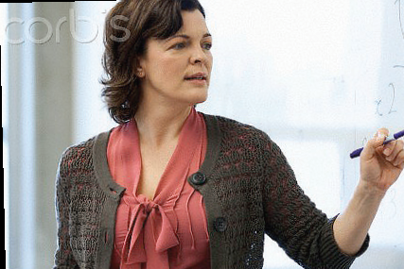



TALIS 2013 Results
An international perspective on teaching and learning
TALIS Conference
Copenhagen
3 October 2014
Julie Bélanger, PhD
Analyst, OECD
1

Slide 2


Mean mathematics performance, by school location, after accounting for socio-economic status
TALIS in Brief
2
Fig II.3.3
Over 100 thousand randomly selected lower secondary teachers and their school leaders from over 6500 schools
…representing more than 4 million teachers in 34 countries…
…took an internationally-agreed survey about the working conditions and learning environments in their schools…
…responding to questions about their background, their teaching practices, support and development, their relationships with colleagues and students and the leadership in their schools

Slide 3





Mean mathematics performance, by school location, after accounting for socio-economic status
TALIS seeks to help with …
3
3
Improve the societal view of teaching as a profession
Recruit top candidates into the profession
Developing Teaching
as a profession
Retain and recognise effective teachers – path for growth
Support teachers in continued development of practice

Slide 4
Mean mathematics performance, by school location, after accounting for socio-economic status
Teachers' perceptions of the value of teaching
4
4
Fig II.3.3
Percentage of lower secondary teachers who "agree" or "strongly agree" that teaching profession is a valued profession in society

Slide 5
The Learning Environment:
Characteristics of Teachers and Schools

Slide 6
Mean mathematics performance, by school location, after accounting for socio-economic status
Work experience of teachers
6
Fig II.3.3

Slide 7
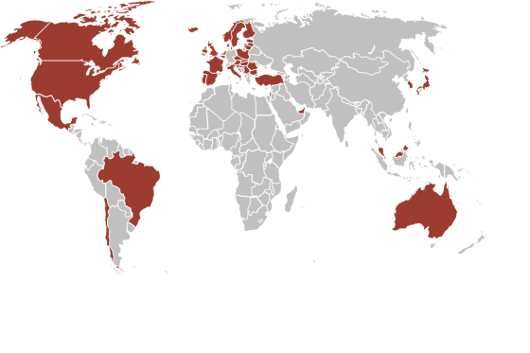


Mean mathematics performance, by school location, after accounting for socio-economic status
TALIS in Brief
7
Fig II.3.3
For a majority of TALIS countries,
Few countries attract the most experienced teachers…
…to the most challenging schools.

Slide 8
Mean mathematics performance, by school location, after accounting for socio-economic status
Distribution of experienced teachers in more and less challenging schools
8
Fig II.3.3
Schools with more than 30% of students from socioeconomically disadvantaged homes
Difference in the proportion of teachers with more than 5 years teaching experience who work in more challenging schools and those who do not
Higher proportion of experienced teachers in challenging schools
Higher proportion of
experienced teachers
in schools that are less
challenging

Slide 9
Mean mathematics performance, by school location, after accounting for socio-economic status
Lack of resources hindering
the school's capacity for quality instruction
9
Fig II.3.3
Percentage of lower secondary teachers whose school principal reports the following issues substantially hinder the school’s capacity to provide quality instruction

Slide 10

Developing and Supporting Teachers

Slide 11
Mean mathematics performance, by school location, after accounting for socio-economic status
Access to induction programmes
11
Fig II.3.3
Percentage of lower secondary education teachers whose school principal reports the existence of formal induction programmes

Slide 12
Mean mathematics performance, by school location, after accounting for socio-economic status
Not everywhere where principals say mentoring is available
do teachers have mentors
12
Fig II.3.3

Slide 13
Mean mathematics performance, by school location, after accounting for socio-economic status
Professional development recently undertaken by teachers by type and intensity
13
Fig II.3.3
 | Percentage of teachers who participated in the following professional development activities in the 12 months prior to the survey | Average number of days of participation among those who participated
Courses/workshops |  | 8
Education conferences or seminars |  | 4
Observation visits to other schools |  | 3
In-service training courses in business premises, public organisations or NGOs |  | 7
Observation visits to business premises, public organisations or NGOs |  | 3
Participation in a network of teachers
Individual or collaborative research
Mentoring and/or peer observation and coaching
Qualification programme (e.g., a degree programme)
73%
4
36%
2
6%
5
5%
7
12%
3
41%
19%
18%
10%

Slide 14
Mean mathematics performance, by school location, after accounting for socio-economic status
Teachers' needs for professional development
14
Fig II.3.3
Percentage of lower secondary teachers indicating they have a high level of need for professional development in the following areas

Slide 15
Mean mathematics performance, by school location, after accounting for socio-economic status
Barriers to professional development participation
15
Fig II.3.3
Percentage of lower secondary teachers who "agree" or "strongly agree" that the following elements represent barriers to their participation in professional development activities

Slide 16

Improving Teaching Using Appraisal and Feedback

Slide 17

Mean mathematics performance, by school location, after accounting for socio-economic status
Teachers and feedback
17
Fig II.3.3
On average across TALIS countries,
Only one in 5 teachers report receiving feedback from
at least
three sources,
… and just over one in ten report never having received feedback in their school.
… and in Denmark. nearly one quarter report never having received feedback in their school.

Slide 18
Mean mathematics performance, by school location, after accounting for socio-economic status
Teachers feedback :
Received after direct classroom observations
18
18
Fig II.3.3

Slide 19
Mean mathematics performance, by school location, after accounting for socio-economic status
Feedback and change in behavior
19
19
Fig II.3.3
Percentage of lower secondary teachers who report a "moderate" or "large" positive change in the following issues after they received feedback on their work
Personal
Pedagogical
Professional

Slide 20

Teacher Practices and Classroom Environment

Slide 21
Challenging classrooms
21
Percentage of lower secondary teachers who report that more than 10% of the students in their class have the following characteristics

Slide 22
Distribution of class time
22
Average proportion of time lower secondary teachers report spending on each of these activities in an average lesson
Average

Slide 23
Teacher co-operation
23
Percentage of lower secondary teachers who report doing the following activities at least once per month
Exchange and co-ordination

Slide 24
Mean mathematics performance, by school location, after accounting for socio-economic status
Teaching practices
24
Fig II.3.3
Percentage of lower secondary teachers who report using the following teaching practices "frequently" or "in all or nearly all lessons"

Slide 25
School Leadership

Slide 26
Mean mathematics performance, by school location, after accounting for socio-economic status
Principals' leadership
26
Fig II.3.3
Percentage of lower secondary education principals who report having engaged "often" or "very often" in the following leadership activities during the 12 months prior to the survey

Slide 27
Mean mathematics performance, by school location, after accounting for socio-economic status
Elements not included in principals' formal education
27
Fig II.3.3
Percentage of lower secondary principals whose formal education did not include:

Slide 28

Teacher Self-Efficacy and Job Satisfaction

Slide 29
Mean mathematics performance, by school location, after accounting for socio-economic status
Teachers' satisfaction with their working environment
29
29
Fig II.3.3
Percentage of lower secondary teachers who "agree" or "strongly agree" with the following statements

Slide 30
Mean mathematics performance, by school location, after accounting for socio-economic status
Behavioral issues equate to lower job satisfaction,
class size doesn’t
30
Fig II.3.3
Teachers' job satisfaction level following the number of students in the classroom in relation to the percentage of students with behavioural problems

Slide 31

Mean mathematics performance, by school location, after accounting for socio-economic status
The importance of in-school relationships
31
Fig II.3.3
Positive interpersonal relationships can help teachers be more
successful in challenging circumstances.
They are also related to higher levels of teachers’ job satisfaction and self-efficacy.
Positive interpersonal relationships can negate the detrimental
effects that challenging classrooms of students might
have on a teacher’s job satisfaction or feelings of self-efficacy.
Positive interpersonal relationships are related to higher levels of
confidence in teachers. In many countries, the association is even
stronger with teacher-teacher relations than with teacher-student
relations.

Slide 32
Mean mathematics performance, by school location, after accounting for socio-economic status
Drivers of self-efficacy and job satisfaction
32
Fig II.3.3
The more teachers report that appraisal and feedback impact classroom teaching,
The more teachers report that they are provided opportunities to participate in school decisions,
The more frequently that teachers report participating in collaborative practices with their colleagues,
the higher their level of self-efficacy.
The same is true
for job satisfaction.

Slide 33
Mean mathematics performance, by school location, after accounting for socio-economic status
Drivers of self-efficacy and job satisfaction
33
Fig II.3.3
But the more teachers report that appraisal and feedback are largely done to fulfil administrative requirements,
the lower their level of self-efficacy.
The same is true
for job satisfaction.

Slide 34
Mean mathematics performance, by school location, after accounting for socio-economic status
Key Messages
34
Fig II.3.3
Collaborative school environment
Meaningful appraisals and feedback are provided to teachers
Teachers play an important role in the development of the school
Schools where teachers feel more effective and are more satisfied with their jobs

Slide 35





Mean mathematics performance, by school location, after accounting for socio-economic status
TALIS partnership
35
Fig II.3.3
TALIS
is a partnership between
an international research consortium
OECD
Governments
in 34 countries
Teachers’ unions
European Commission

Slide 36
Mean mathematics performance, by school location, after accounting for socio-economic status
TALIS partnership
36
Fig II.3.3
  THANK YOU FOR LISTENING!
  Find out more about TALIS at www.oecd.org/talis
    All national and international publications
    The complete micro-level database
  Email:
  Julie.Belanger@oecd.org

